Slide 1
Subject | ENGLISH
Grade | 2 year 1
Term | 3

Slide 2
LESSON PLAN CONTENT
Week 1 -3 | TRANSPORT
Week 4-5 | ROAD/TRAFFIC SAFETY
Week 6-7 | PEOPLE WHO HELP US IN OUR COMMUNITY
Week 8-9 | FRUITS AND VEGETABLES

Slide 3
LESSON OBJECTIVES
Learners will be able to:
Use language to perform
Use auditory, visual and pictorial cues to
make meaning
Use language for communication
Follow simple classroom instructions
Participate in discussions
Build oral vocabulary
Identify letter-sound relationship of single
letters
Blend three-letter words with the taught word families
Practice eye movements: use a toy car (or any other object), place the car on the table to the left. Push the car across the table to the right and learner follows the car with his/her eyes trying to keep the head still.
Do activities to develop foreground/background: Learners identify an image in a busy picture.
Use pictures to understand simple phrases and sentences in a book
Match words to objects: match labels to labeled items on an interest table

Slide 4
ASSESSMENT GOALS
Listen to stories and respond to questions • Use visual and pictorial cues to make meaning • Process information • Compare and classify information • Use language for communication • Solve and complete ten or more piece jig-saw puzzles • Match things that go together and compare things that are different | EMERGENT READING • Use pictures to understand simple phrases and sentences in a book • Match words to objects • Use the picture on the front cover to predict what the story is about • Use pictures to understand simple phrases and sentences in a book. • Distinguish pictures from print: points to a word and ask what the word is • Discuss the title of the book/story • “Read” and recognise high frequency words and sight words • Recognise phonic sounds that have been taught • Recall details and states main idea from a story
PHONOLOGICAL AWARENESS AND PHONICS • Identify letter-sound relationship of single letters • Distinguish between different medial letter sounds in three-letter words Build and blend words with the word families that were taught. • Recognise and names some letters of the alphabet | HANDWRITING • Make patterns with finger paint • Trace simple outlines of pictures, patterns and own name • Start to write letters in own name

Slide 5
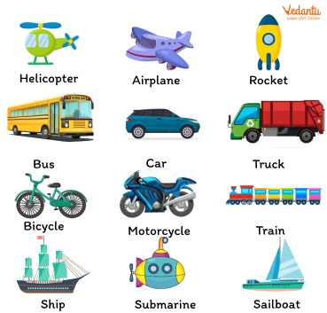
TRANSPORT

Slide 6
GROUP 1

Slide 7
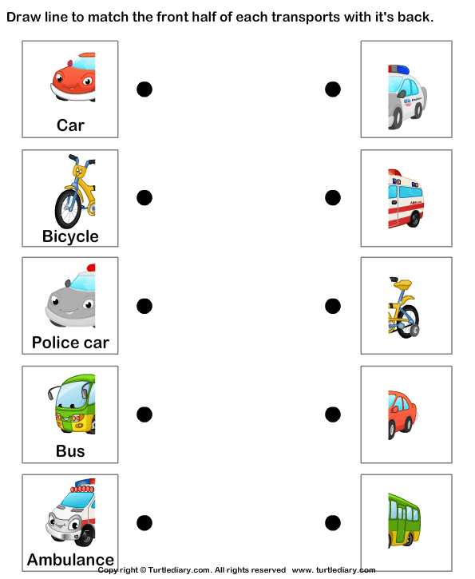

Slide 8
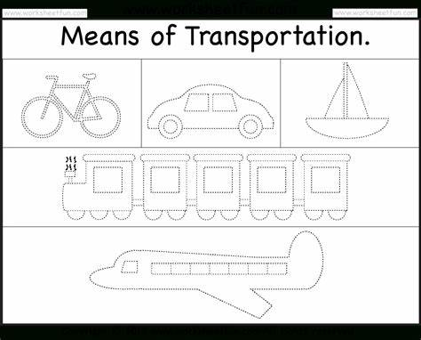

Slide 9
GROUP 2

Slide 10
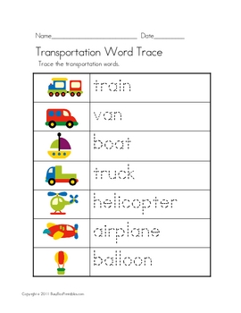

Slide 11
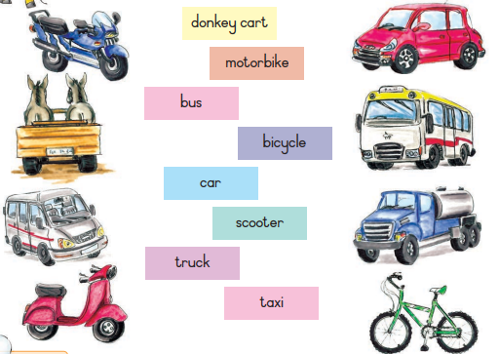
Draw a line to match each picture with the right word

Slide 12
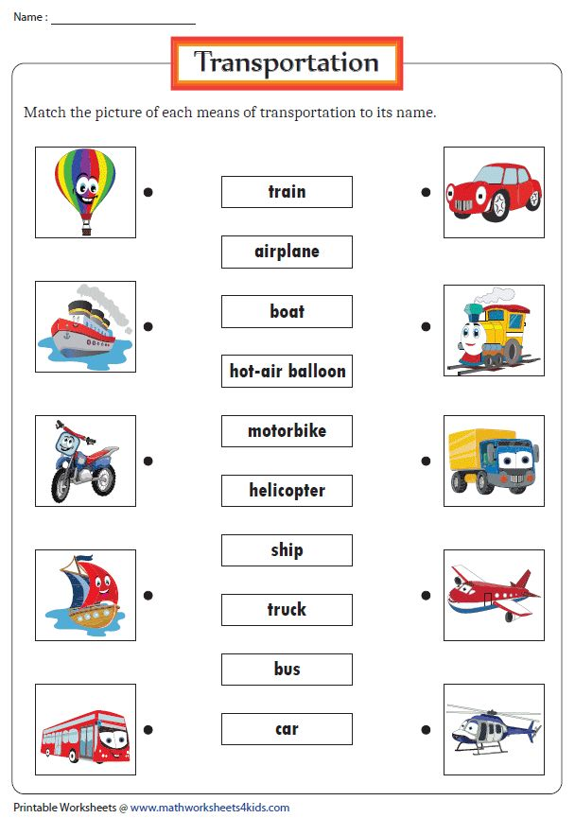

Slide 13
GROUP 3

Slide 14
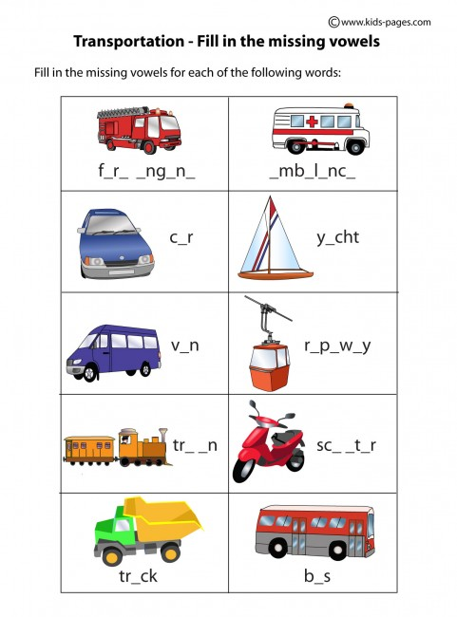

Slide 15


Slide 16
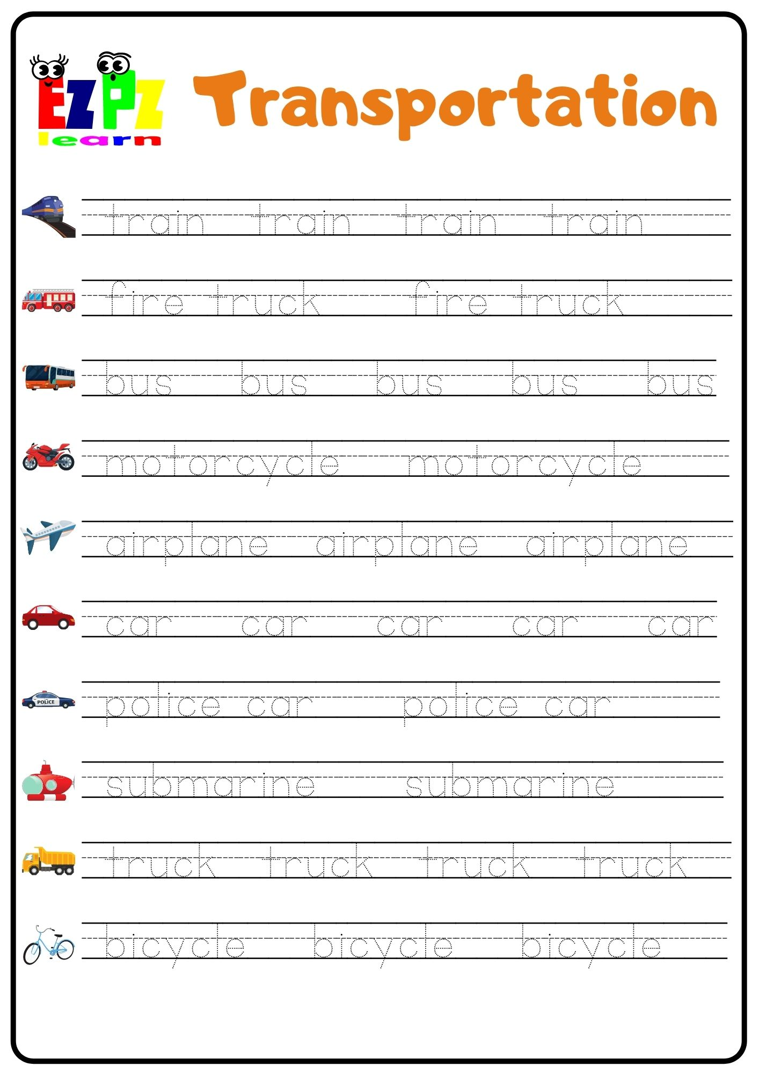

Slide 17
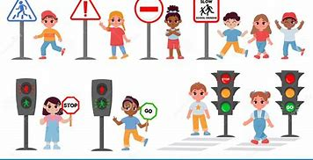
ROAD/ TRAFFIC SAFETY

Slide 18
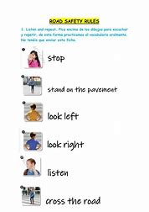

Slide 19
GROUP 1

Slide 20


Slide 21


Slide 22
GROUP 2

Slide 23
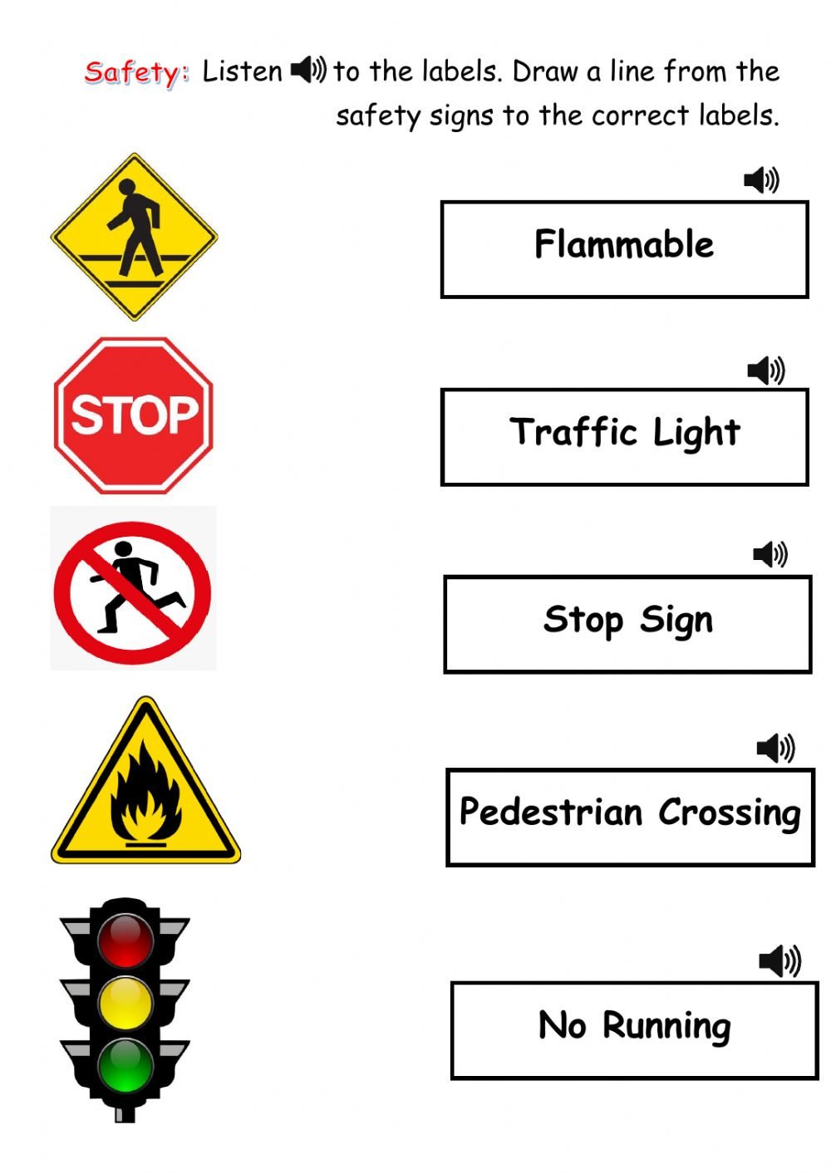

Slide 24
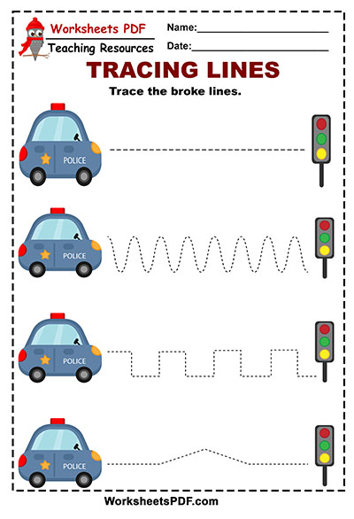

Slide 25
GROUP 3

Slide 26


Slide 27
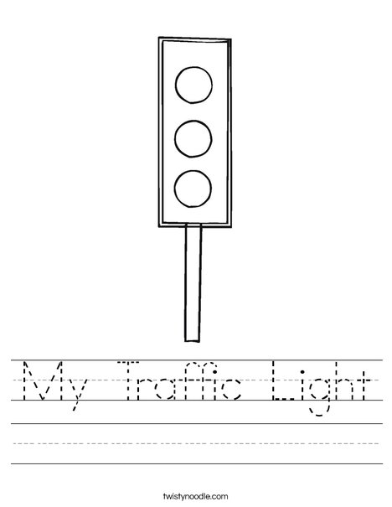
Colour and trace

Slide 28
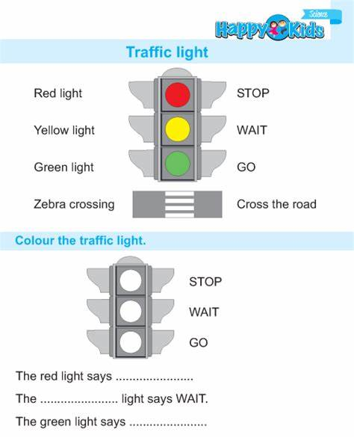

Slide 29

PEOPLE WHO HELP US

Slide 30
GROUP 1

Slide 31
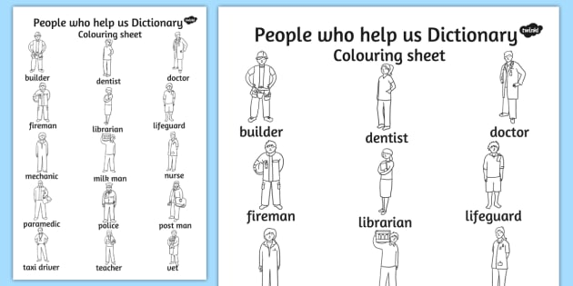

Slide 32
Group 2

Slide 33
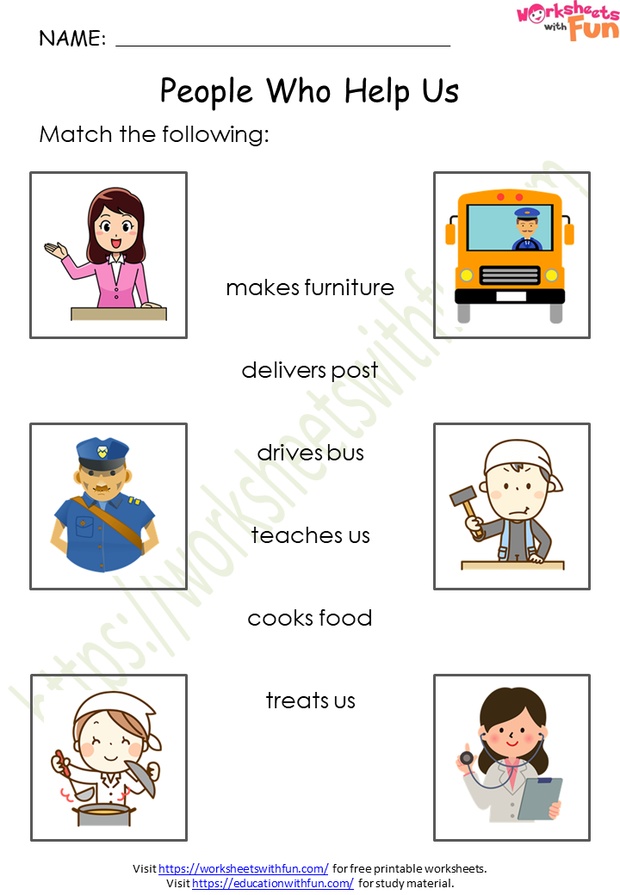

Slide 34
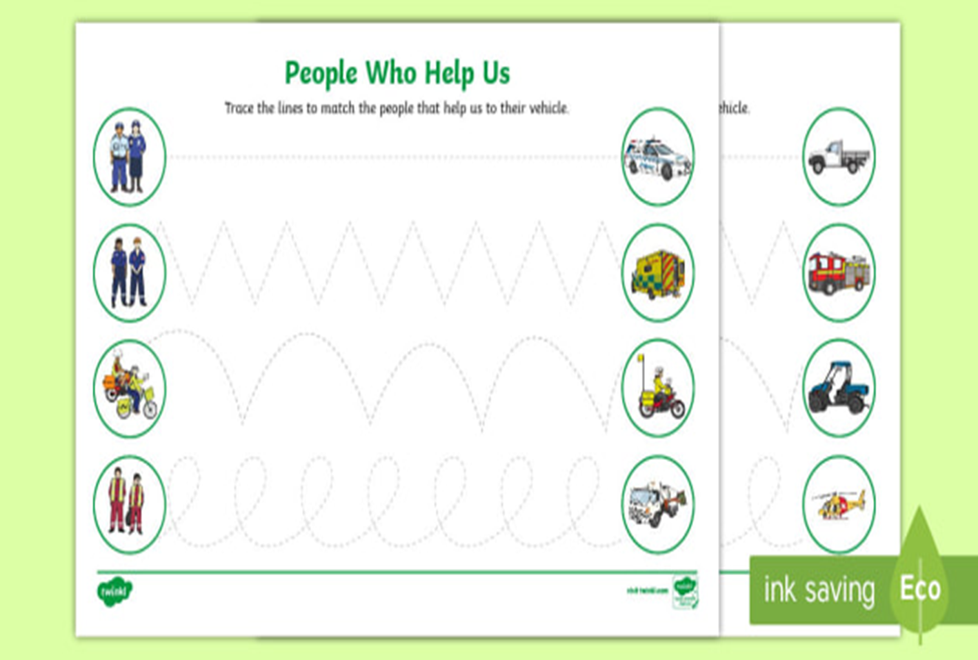

Slide 35
Group 3

Slide 36


Slide 37


Slide 38
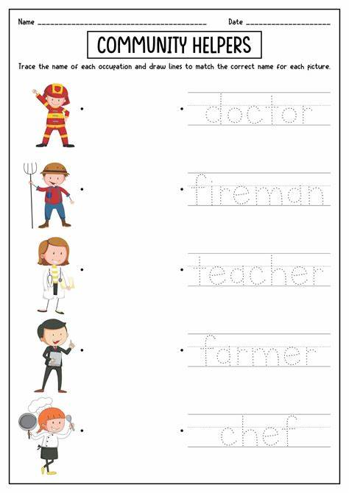

Slide 39
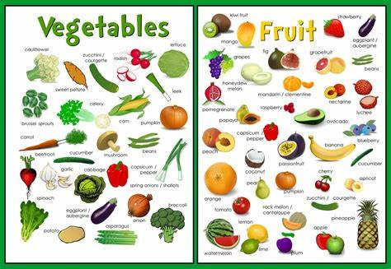
FRUIT AND VEGETABLES

Slide 40
GROUP 1

Slide 41
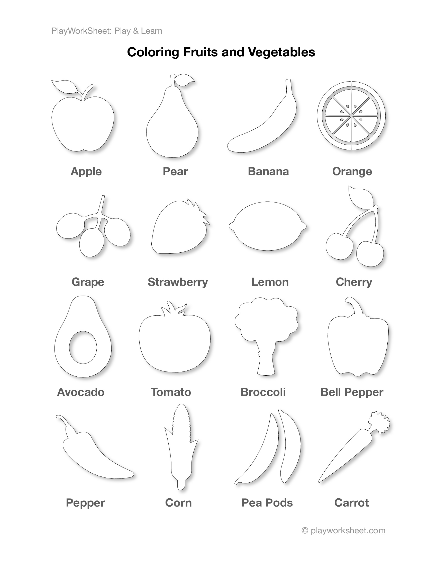

Slide 42
GROUP 2

Slide 43
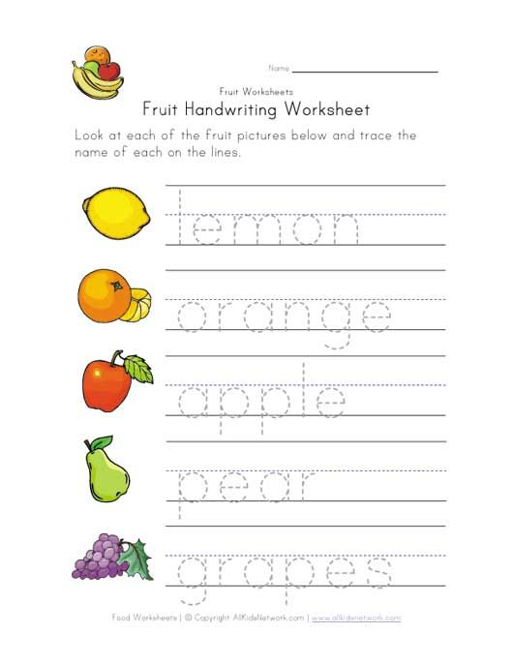

Slide 44


Slide 45
GROUP 3

Slide 46


Slide 47
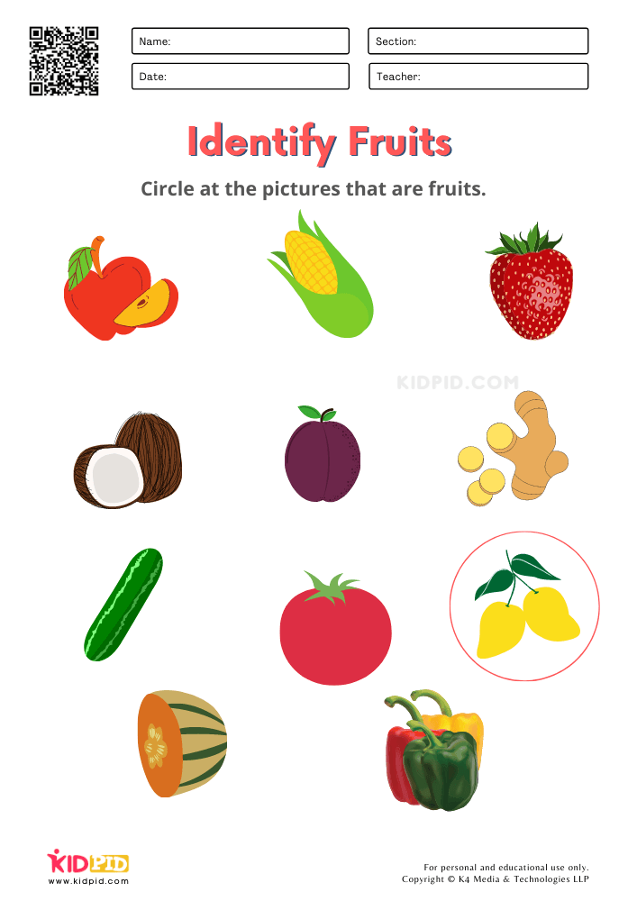

Slide 48
REFERENCES
https://cdn4.vectorstock.com/i/1000x1000/81/78/transport-cartoons-vector-598178.jpg
https://th.bing.com/th/id/R.4bedde0a34a46c3f8476e8a9c3193ea9?rik=HzmXgDwWSMiEgg&riu=http%3a%2f%2fcdn.turtlediary.com%2fworksheets%2fela%2fpreschool%2fmiscellaneous%2fland-transport-match-the-parts%2fquestion%2fland-transport-match-the-parts-1.png&ehk=QmUIA1EFbE4f0svBv4Cz5sxyTCRyjPK21lGTtr58rpw%3d&risl=&pid=ImgRaw&r=0
https://www.kids-pages.com/folders/worksheets/Transportation/TransportationFillIn.jpg
https://th.bing.com/th/id/OIP.fRSAqPJELZxVQ3CRL-bfpgAAAA?rs=1&pid=ImgDetMain
https://th.bing.com/th/id/OIP.j1aGQgbLnwFPQ_I9JjVwygHaKe?w=178&h=252&c=7&r=0&o=5&pid=1.7
https://th.bing.com/th/id/OIP.sfoXR83NPVP-oQz6Fw5fKgAAAA?w=178&h=241&c=7&r=0&o=5&pid=1.7
https://th.bing.com/th/id/OIP.Nf6VTxle16YtwHqxzvj24QAAAA?rs=1&pid=ImgDetMain
https://th.bing.com/th/id/OIP.G22CAwskSgcV--pN-tS4-gAAAA?rs=1&pid=ImgDetMain
https://i.pinimg.com/474x/8c/e3/85/8ce385035bc3affdf3f880752a62d2b2--people-who-help-us-activities-people-who-help-us-eyfs.jpg
https://th.bing.com/th/id/OIP.4dLKYDU8JIlA6pehEYnW1wAAAA?w=178&h=252&c=7&r=0&o=5&pid=1.7

Slide 49
REFERENCES
https://th.bing.com/th/id/OIP.7a0179VL3C9kPRM2vedC4wHaKN?w=178&h=246&c=7&r=0&o=5&pid=1.7
https://th.bing.com/th/id/OIP.VydevZbGqs48ggbXpXXr3QAAAA?rs=1&pid=ImgDetMain
https://th.bing.com/th/id/OIP.rCuRyffpd2A5GWu-FpGZyQAAAA?w=178&h=257&c=7&r=0&o=5&pid=1.7

